Slide 1


Image recognition with IBM cloud visual recognition
PHASE 3

Slide 2
Team Members
N.RAJALAKSHMI
A.REBEKKA
B.RABIYA BEGUM
D.MUNISHA
S.JAMUNA
R.HARISHWARI
J.VIJAYALAKSHMI

Slide 3
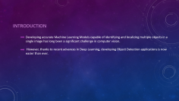

INTRODUCTION
Developing accurate Machine Learning Models capable of identifying and localizing multiple objects in a single image has long been a significant challenge in computer vision.
However, thanks to recent advances in Deep Learning, developing Object Detection applications is now easier than ever.

Slide 4
ACHIEVING PRECISION
One of the technologies to consider is objected acknowledgment innovation, later known as object detection.
This term denotes a capacity to identify the shape size of diverse objects, and the device's camera catches their position.
The practice of detecting real-world object instances in still photos or videos, such as a car, bike, Television, flowers, and humans, is known as object detection

Slide 5
System on Laptop
Blind person
Keep the images you have captured
Capture Image
Input from the
camera
The image pre processing
Recognize the object in the captured image
Determine the object distance from the person
Output Audio
Transfer the audio signal
Create an audio signal for the object that has been identified

Slide 6
Vision Voice
The framework is built up in such a way that an android application (assuming you're executing it on an Android gadget) can record real-time outlines and transfer them to the program's background, where all the computations take place.
The video stream is sent and received as an input in the application's background, where it is tested and detected using accurate metrics by the COCO DATASETS object detection model.
After testing with voice modules, the path of the object will be transformed into standard voice notes, which can be delivered to blind people for help.
In addition to object discovery, we have used an alarm framework to calculate an estimate.
If the Blind Person is exceptionally close to the diagram or is far away in a more secure location, it will produce voice-based results in addition to distance units.

Slide 7
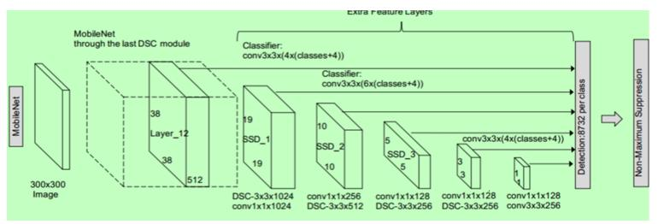
Ssd architecture

Slide 8
TensorFlow Object Detection API depends on the libraries mentioned
Protobuf 3.0.0
Python-tk
Pillow 1.0
Lxml
tf-slim
Slim
Jupyter notebook
Matplotlib
Tensorflow (1.15.0)
Cython
Contextlib2
cocoapi

Slide 9
Coding
(boxes,scoresclasses,num detections)=sess.run([boxes,cores,classes,num detections),feed dict={image tensor:image np expanded})
for i,b in enumerate(boxes[0]):
boxes[0][i][0]-y axis upper start coordinates
boxes[0][i][1]-x axis left start coordinates
boxes[0][i][2]-y axis down start coordinates
boxes[0][i][3]-x axis right start coordinates
apx distance=round(((1-(boxes[0][i][3]boxes[0][i][1]))**4),1)
Mid x = (boxes [0] [i] [1]+boxes [0] [i] [3])/2
Mid y =(boxes [0] [i] [0]+boxes[0] [i] [2])/2
Apx distance=round (((1-boxes[0] [i] [3]- boxes [0] [i] [1])))**4,1)

Slide 10
Conclusion
Several technologies have been created to aid visually impaired persons.
One such attempt is that we would wish to make an Integrated Machine Learning System that allows the blind victims to identify and classify real-time objects generating voice feedback and distance.
Which also produces warnings whether they are very close or far away from the thing.
For visually blind folks, this technology gives voice direction. This technique has been introduced specifically to assist blind individuals.
The precision, on the other hand, can be improved.
Furthermore, the current system is based on the Android operating system; it can be altered to work with any device that is convenient.

